Slide 1

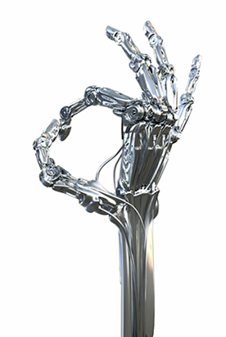
PhD Confirmation Meeting
______ber 2019
Peter Donnelly
peter.donnelly@petermac.org
Notes:
This is a talk about what we are doing at Peter Mac to move high throughput sequencing into the clinical pathology area.
We’ve built a web application called Path-OS (for pathology operating system) to manage our variants.
In contrast to a lot of the talks in this forum it’s a bit more focused on software engineering than bioinformatics.

Slide 2

Agenda
Background & Motivation
Current State of ML in Cancer Diagnosis
My Work to Date
Main Opportunity Areas
The Project
  Aim 1, Aim 2, Aim 3
Wednesday, 2 October 2019
HUB Path-OS
Notes:
A bit of signposting…

Slide 3
Background & Motivation
Notes:
I’ll just go through some background of the project

Slide 4
Context and Motivation
Machine Learning making explosive progress since about 2012
  A Key Event: AlexNet 2012
  Why? Alignment of planets
    Hardware power & suitability of GPUs for parallelizing ML processing (Linear Algebra)
    Refinements to longstanding algoirthms eg. ReLu, Regularization …
ML is emerging as universal tool
  Every discipline / profession / research field is looking to see what ML might to for them
  Including essentially every medical field …
    Used clinically in only a small number of applications – e.g. detecting glaucoma
  … and oncology in particular
    But still very much pre-clinical
ML holds great promise for oncology
  Many important oncology problems are classification problems, and ML is good at this
  Current practice are highly manual and time consuming and require much judgment
  ML models are accretive & once developed can be disseminated at very low cost
But there are significant challenges
  Not yet known which applications are a good match
  Lack of quality labeled data is a hindrance
  Skill chasm: ML researchers know little about oncology and vice-versa
    Emergence of bioinformatics as a specialized category
    Modern genomics brought IT and big data skills with it, so base of expertise exists
Wednesday, 2 October 2019
HUB Path-OS
Notes:
So these are some of the issues with most current molecular pathology services.
Things are likely to get more complex as more is learned about disease pathology and epigenetics gets used.
It really comes down to a data filtering exercise, processing the variants and evidence in a clinically usable timeframe.

Slide 5
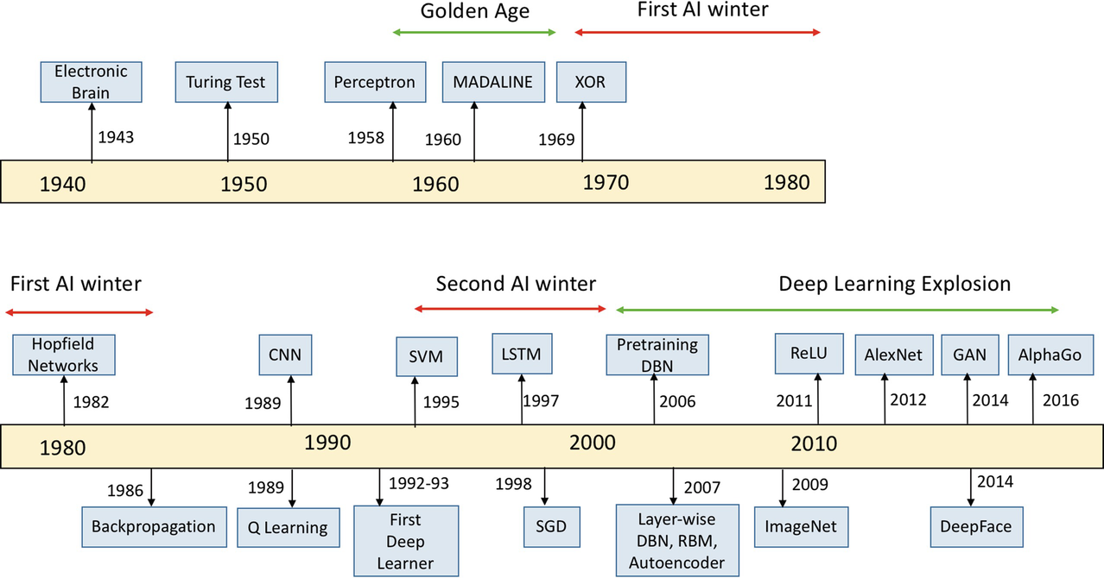
Capsule History of AI
Source: Kamath U., Liu J., Whitaker J. (2019) Introduction. In: Deep Learning for NLP and Speech Recognition. Springer.

Slide 6
Current State of ML in Cancer Diagnosis
Notes:
I’ll just go through some background of the project

Slide 7
Current State of ML in Cancer Diagnosis
Analysing Gene Sequences
Histopathology
Text Summarization
Knowledge Extraction
Wednesday, 2 October 2019
HUB Path-OS
Notes:
So these are some of the issues with most current molecular pathology services.
Things are likely to get more complex as more is learned about disease pathology and epigenetics gets used.
It really comes down to a data filtering exercise, processing the variants and evidence in a clinically usable timeframe.

Slide 8
My Work to Date
Notes:
I’ll just go through some background of the project

Slide 9
My Work to Date
Acquiring Relevant Domain Knowledge
  Cell biology and cancer genomics (reading and lectures)
  Cancer Pathology Processes
    Learing about PMCC roles, workflows and systems
    Gene Sequencing & Curation (reading, interviews, lectures)
  Histopathology (reading and lectures)
Establishing and methodically using reference management system (Zotero based)
ML Infrastructure
  Home Environment: for learning and rapid model development / tweaking
  AWS (Cloud) P3 Spot Instances: for large scale learning
  PMCC ML facility
Deep Dives into relevant contemporary ML algorithms, models, techniques including
  Convolutional Neural Networks
  Long Short Term Memory (LSTM) RNN networks and Attention Models
  Transformer Models, in particular Google Brain’s Tensor2Tensor implementation
  Word Embedding (eg. Word2Vec, Glove …)
Trying out and existing relevant ML applications
  Text Summarization using LSTM (model: ‘Long-Summarization’)
  Analysis of cancer pathology samples using CNN (‘QUIP’)
  Text2Text applications using Transformer models (Google Brain‘Tensor2Tensor)
Locating and experimenting with useful tools and datasets
  digitally accessible portions of the literature (PubMed Central)
  well known & best practice datasets (e.g. disease, gene and drug ontologies)…
Circumscribing and homing in on a tractable problem (subsequent slides)
  Relevant, Achievable, Interesting, Reasonable likelihood of success
Wednesday, 2 October 2019
HUB Path-OS
Notes:
So these are some of the issues with most current molecular pathology services.
Things are likely to get more complex as more is learned about disease pathology and epigenetics gets used.
It really comes down to a data filtering exercise, processing the variants and evidence in a clinically usable timeframe.

Slide 10
Opportunity Areas & Assessments
Notes:
I’ll just go through some background of the project

Slide 11
Opportunity Areas & Assessments
Automated Histopathology Sample Analysis tool
  How: Using CNN or Captioning Model (Image to Text)
  Assessed Level of Innovation: Low if CNN; High if Captioning
  Notional Difficulty: Medium if CNN based; Medium if Captioning based
  Likelihood of Successful Outcome: Medium if CNN based; Unknown if Captioning based
Literature Summarizing Tool for Curators
  How: Using either LSTM or Transformer
  Assessed Level of Innovation: Low - Medium
  Notional Difficulty: High
  Likelihood of Successful Outcome: Low - Medium
Knowledge Extraction from the Literature
  How: Using techniques such as …
  Assessed Level of Innovation: Medium
  Notional Difficulty: Medium
  Likelihood of Successful Outcome: Medium
End-to-End Gene Curation using Captioning Model
  How: Captioning Model (Gene Sequence to Text)
  Assessed Level of Innovation: High
  Notional Difficulty: Unknown but probably High
  Likelihood of Successful Outcome: Unknown
Cancer Classification using orthogonal data sources (eg. gene sequence + blood test results)
  How: Multi-mode NN model (eg. CNN + LSTM)
  Assessed Level of Innovation: Medium
  Degree of Difficulty: High (hard to acquire the data)
  Likelihood of Successful Outcome: Unknown
Wednesday, 2 October 2019
HUB Path-OS
Notes:
So these are some of the issues with most current molecular pathology services.
Things are likely to get more complex as more is learned about disease pathology and epigenetics gets used.
It really comes down to a data filtering exercise, processing the variants and evidence in a clinically usable timeframe.

Slide 12
Notional Project
Notes:
I’ll just go through some background of the project

Slide 13
Notional Project
Build a ML model to predict Lymphona subtype using nanostring data and/or WSI
Must be something that a human can verify
Aim 1
  Image only
Aim 2
  Nanostring only (microarray)
Aim 3 (stretch)
  to do a combined model
  Nanostotring + Images
Wednesday, 2 October 2019
HUB Path-OS
Notes:
So these are some of the issues with most current molecular pathology services.
Things are likely to get more complex as more is learned about disease pathology and epigenetics gets used.
It really comes down to a data filtering exercise, processing the variants and evidence in a clinically usable timeframe.

Slide 14
Introduction
Lit searcg
Aim1
To identify and articulate the technical, logistical and organisational barriers to entry for the adoption of high throughput sequencing (HTS) in a clinical oncology setting.
Aim2
To develop the methodologies and software engineering systems necessary for the processing of HTS data from sequencer through to a clinical report.
Aim3
To anticipate the possible technology directions for molecular diagnostics in cancer and develop software architectures and systems that can address future sequencing needs in a scalable manner.
Conclusion/Discussopon
Wednesday, 2 October 2019
HUB Path-OS

Slide 15

Cahpters

Slide 16
Towards automated curation
Four key dimensions for a variant
Artifact Score: assay specific probablity
Resulting from technical errors in panel processing
Free of technical errors in panel processing
Database/Literature Score: categorical/qualitative
No known occurrences in data sources
Expert curated in multiple databases
Pathogenicity Score: context specific probability
Benign
Pathogenic
Actionability Score: categorical/qualitative
No known therapy for this variant
PBS approved therapy or open clinical trial
Wednesday, 2 October 2019
HUB Path-OS

Slide 17
Issues with pathology practices
Not scalable for NGS data generated, in the future…
  Multi-gene panels: 50 – 200+ genes
  Deep sequencing: low frequency variants
  High throughput: 100’s samples per seq. run
  More false positives
  More polymorphisms
  More VUS
Not scalable for analysis
  People limited: the number of minutes per variant
    Molecular Pathologists
    Curators
    Bioinformaticians
  More databases
    inconsistent nomenclatures, semantics and interfaces
  More literature, evidence
    inconsistent nomenclatures, semantics, diseases
    actual variants buried in text or supplementary files
Lack of clinical quality databases
  Labs aren’t depositing classified variants in the public domain
    Legal risks
    Commercial reasons
    Laziness
  If they do, can the data be trusted ?, what is the evidence recorded
Wednesday, 2 October 2019
HUB Path-OS
Notes:
So these are some of the issues with most current molecular pathology services.
Things are likely to get more complex as more is learned about disease pathology and epigenetics gets used.
It really comes down to a data filtering exercise, processing the variants and evidence in a clinically usable timeframe.

Slide 18
Notes:
Is it of any use to Piers and Yamuna
Actual proposed aims as opposed to theoretical aims
Validate that we can get data, or alternatively how can we get the data (who do we have to hassle)
Frame it very narrowly

